Slide 1
Random Forest
Team 17
Duncan Wingfield, Jessy Sun, Nada Liang, Travis Li

Slide 2
MACHINE LEARNING WEDNESDAY!

Slide 3
We are standing on the shoulders of Professor Murray and
Group 18
to talk about

Slide 4

CUSTOMER CHURN

Slide 5
A BRIEF INTRO TO THE DATASET
Predictors → Whether this company will lose this specific customer
No： not lose this customer
Yes: lose this customer

Slide 6
Naive Prediction
Single Tree
Many Trees
(Ensemble Model)
Other Models
*Comparison
*Problem sets
Use most common category to predict
Classification tree (R)
Case
Bagging (R)
Random Forest (R)
LDA, QDA, KNN, Logistic Regression

Slide 7

NAIVE PREDICTION
IS THE ACCURACY 0.839 GOOD OR NOT?

Slide 8

TRY A SINGLE TREE
Let’s review some concepts

Slide 9
CONCEPT TIME
Single Decision Tree

Slide 10
Classification tree
Regression Tree
Response: (continuous or quantitative output)
Mean response of a leaf → prediction
Response: (categorical output)
Most common response → prediction
*salary of a baseball player
← Number of years he has played (Years)
← Number of hits he made in the previous year (Hits)

Slide 11
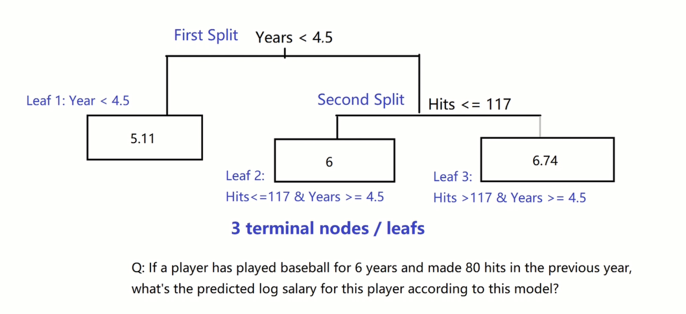
Regression Tree (Predict log salary of a baseball player)

Slide 12
CASE TIME IN R
Model 2: Single Classification Tree → Customer Churn

Slide 13
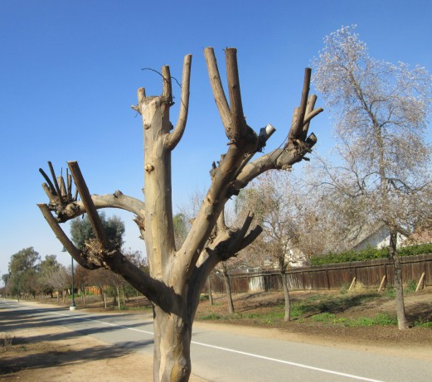
A Pruned Single Tree
ACCURACY : 0.896

Slide 14
Type 1 v Type 2 error
No
Yes
No
862
0
0
TYPE I
Naive
TYPE I: FALSE POSITIVE
A LOYAL CUSTOMER => PREDICT LEAVING
Yes
138
0
1
TYPE II
No
Yes
No
828
11
0.013
Single
TYPE I
TYPE II: FALSE NEGATIVE
A LEAVING CUSTOMER => PREDICT LOYALTY
Yes
93
68
0.578
TYPE II

Slide 15
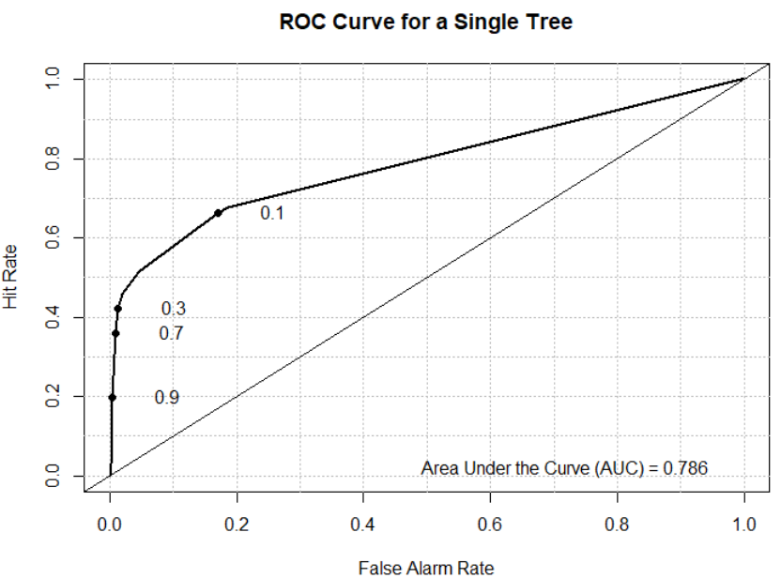
ROC
TRADE-OFF
BETWEEN I AND II
auc-naive:0.5
auc-single:0.786

Slide 16
Advantages & Disadvantages of single trees
Easy to explain
Mirror human decision-making
Displayed graphically
Easy interpretation
No need to create dummy variable
Not predictively accurate
High variability
A different sample would produce a very different decision tree.

Slide 17

To make trees better
CREATE A FOREST

Slide 18
CONCEPT TIME
Ensembling
Bagging

Slide 19
Ensemble
Combining multiple models → a single “ensemble" model
Much more robust to changes in the data
Reduce variance: single decision trees often have high
Tolerant of noise
Notes:
build hundreds of decision trees → combines them into a single model
tolerant of noise.
Being robust to noise means that small changes in the training dataset will have little, if any, impact on the final decisions made by the resulting model (

Slide 20
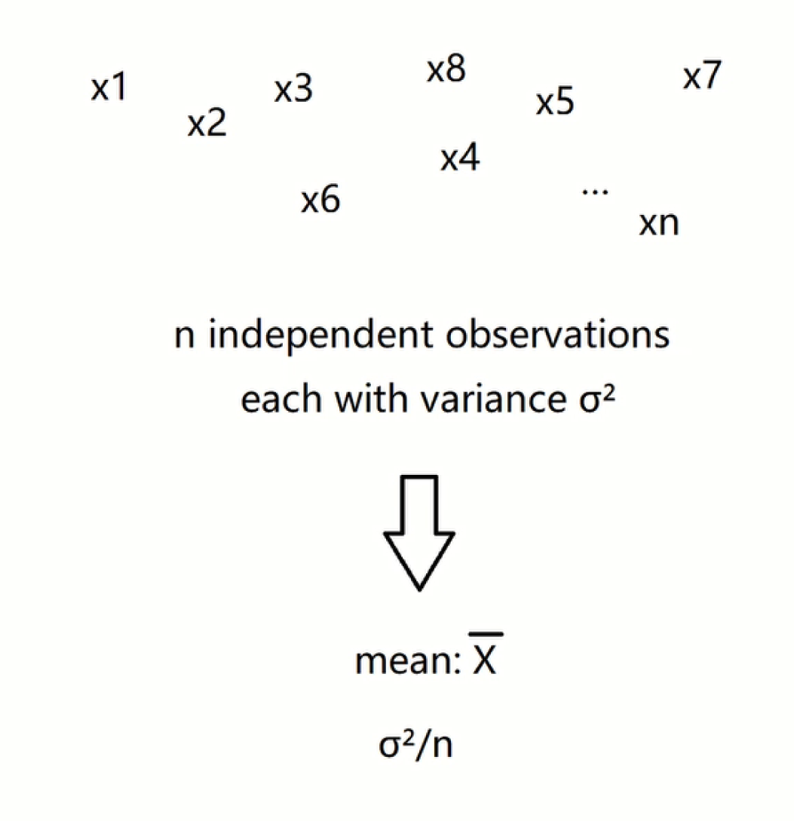
Average a set of observations

Slide 21
What is the temperature
going to reach tomorrow?

Slide 22
Continue → trees
Take many training sets from population
Build a separate prediction model using each training set
Average the resulting predictions

Slide 23
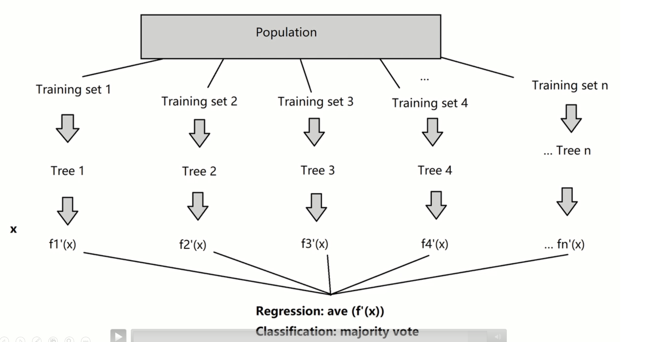

Slide 24
Bagging
Not practical to access multiple training set → bootstrap by taking repeated samples from training data set
Generate B different boot strapped training data sets.
Build B trees by B bootstrapped training set
Average resulting predictions
OOB error→ leave-one-out cross-validation error → estimate test error

Slide 25
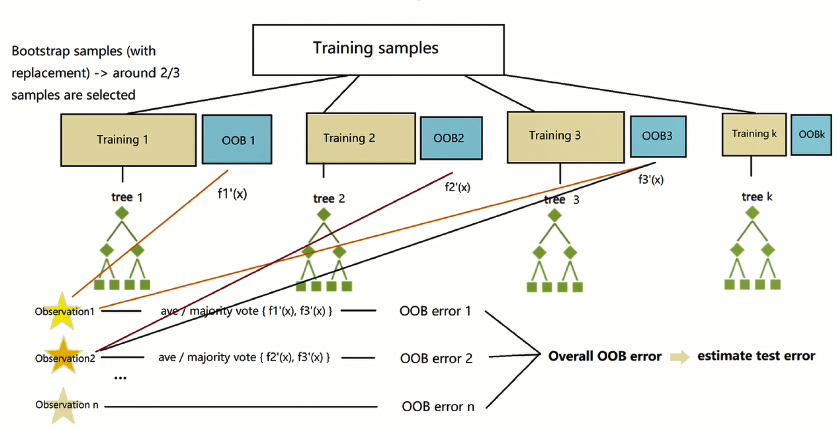

Slide 26
CASE TIME
Model 3: Bagging → Customer Churn

Slide 27
Bagging
auc-single:
auc-bagging:
acc-single:
acc-bagging:

Slide 28
Advantages & Disadvantages
Improved accuracy
Reduce variability
Obtain an overall variable importance (by RSS or Gini index)
Difficult to interpret
Correlation/ similarity of trees

Slide 29
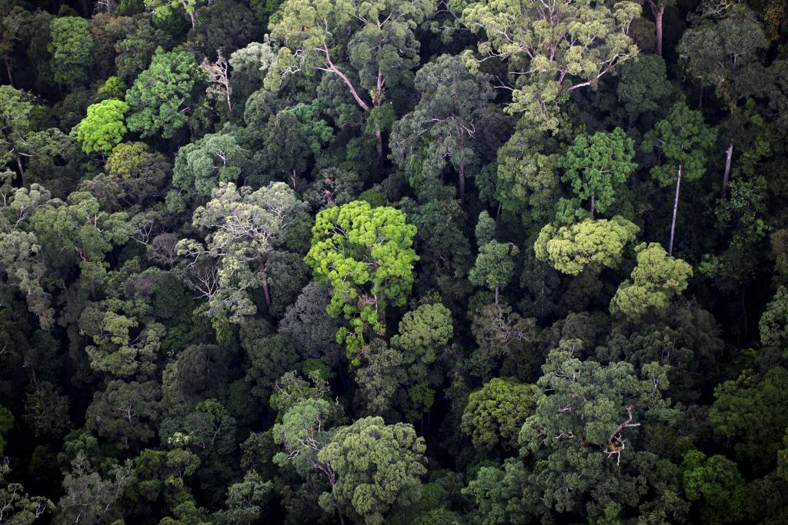
Let trees be crazier
RANDOM FOREST

Slide 30
CONCEPT TIME
Random Forest

Slide 31
Reminder:
To make a better ensembling result
We should make trees as different as possible

Slide 32
•With random forests, the stronger predictors are not automatically chosen
•Instead, unlike building a single decision tree, the algorithm will select a random subset of the observations available in the training dataset.
•In the process of building the decision tree, we use only a small fraction of all of the available variables
•These randomly chosen variables are considered when determining how to best partition the dataset.

Slide 33
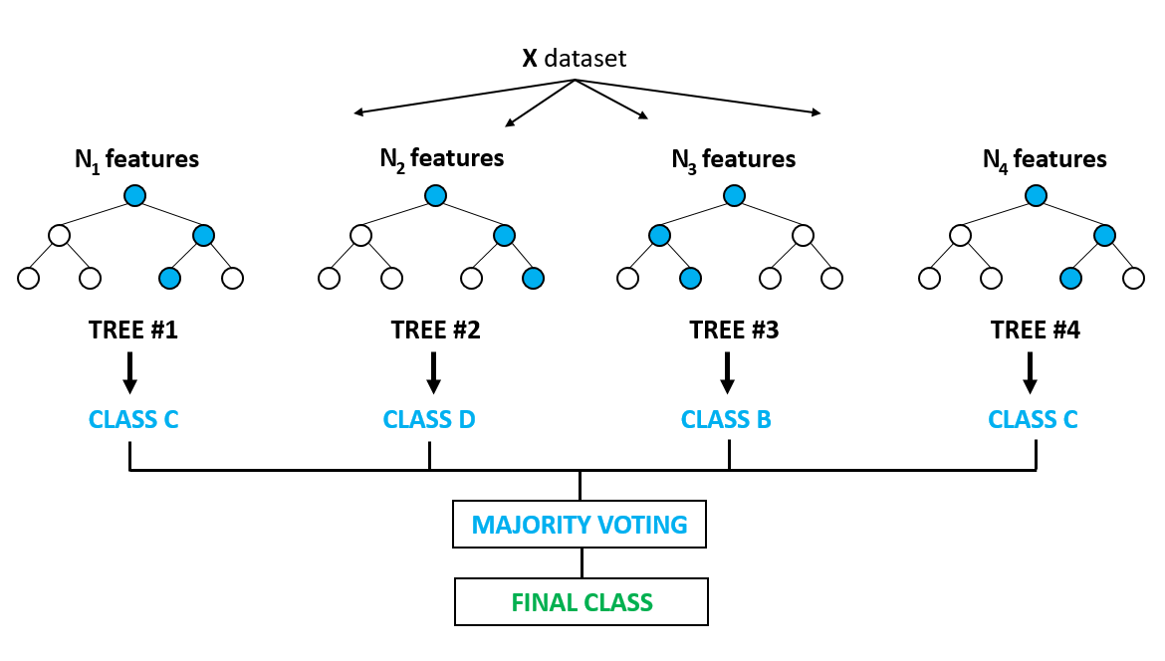

Slide 34
Hyperparameters
•Use trees as building blocks to construct more powerful prediction models
used to increase the predictive power of the model or to make the model faster
•Decision trees suffer from high variance, results can get shaky when splitting training data sets
•We actually decorrelate the trees
•As a general rule of thumb, each split should be equal to
m=√p

Slide 35
CASE TIME
Cross Validation → “mytree”
Model 4: Random Forest → Customer Churn

Slide 36
auc-single:
auc-bagging:
auc-random:
acc-single:
acc-bagging:
oob-bagging:
acc-random:
oob-random:
Random forest:
Penalizing variance more

Slide 37
Advantages
•Can be used in both regression and classification models
•Randomness delivers considerable robustness to noise, outliers, and overfitting, when compared with a single-tree classier.
•The randomness also delivers substantial computational efficiencies.
•By building each decision tree to its maximal depth, we can end up with a model that is also less biased.
•Each individual tree will overfit the data, but this is outweighed by the multiple trees using different variables and (over) fitting the data differently.

Slide 38
CONCEPT TIME
Variable Importance

Slide 39
Variable Importance
A large value → an important predictor
Total amount RSS decreased due to splits over a given predictor, averaged over all B trees
Total amount that Gini index is decreased by splits over a given predictor, averaged over all B trees
Regression
Classification

Slide 40
CASE TIME
Variable Importance

Slide 41
auc-single:
auc-bagging:
auc-random:
acc-single:
acc-bagging:
oob-bagging:
acc-random:
oob-random:
acc-random-vi:
oob-random-vi:

Slide 42
A BETTER SUBSET SELECTION METHOD
TALK WITH YOUR BOSS WITH CONFIDENCE

Slide 43
IN REAL WORLD, TYPE II ERROR SEEMS TO BE MORE IMPORTANT FOR THIS CASE

Slide 44
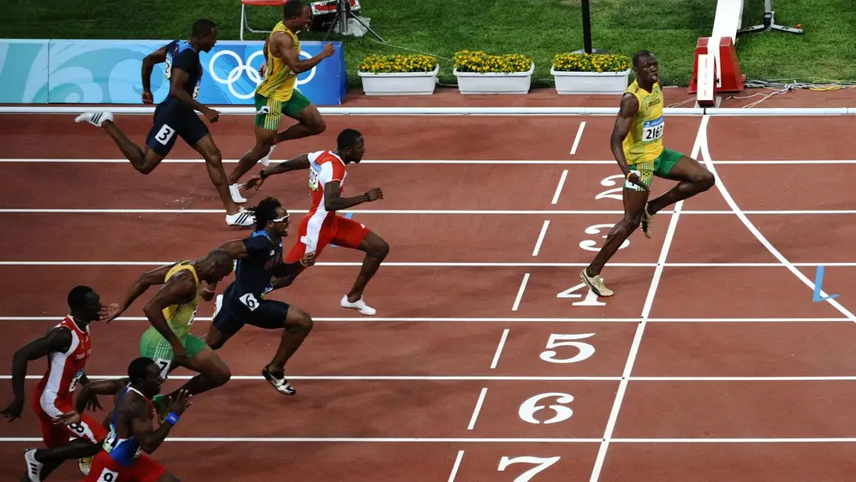
We are not
comfortable though

Slide 45
CASE TIME
Compare with other models:
KNN, LDA, QDA, Logistic Regression

Slide 46
LOGISTIC REGRESSION:
LDA:
QDA:
KNN:
RANDOM FOREST:

Slide 47
CASE TIME

Slide 48

PROBLEM SETS

